Slide 1



Slide 2
Investments Opportunities in Airbnb Properties
Should you invest in an Airbnb hotel in Washington, D.C.? If so, in which neighbourhood should you invest, based on:
How much revenue do best neighbourhoods make?
Which neighbourhoods receive the most positive reviews?

Slide 3
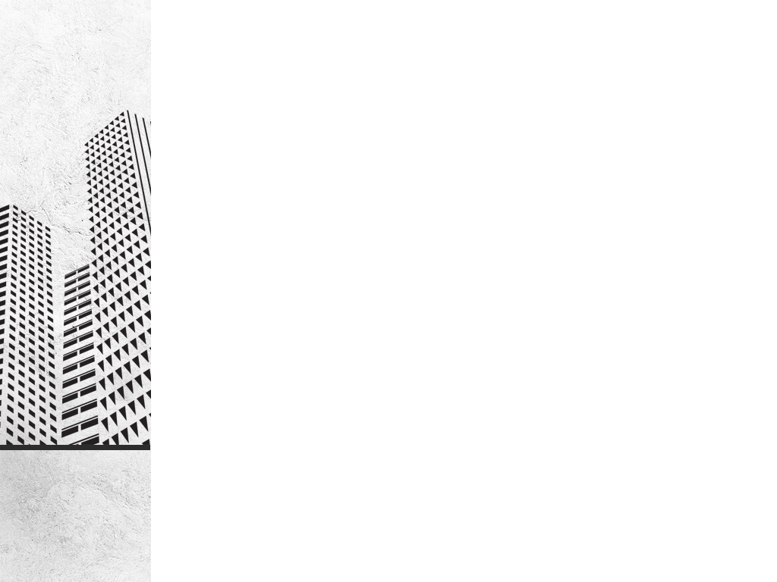
Cleaning Methods:
Duplicates: There is no duplicates in the database.
Deleted Columns: Unneeded columns were deleted.
Excluded rows: the rows related to other than Washington DC state were excluded.

Slide 4
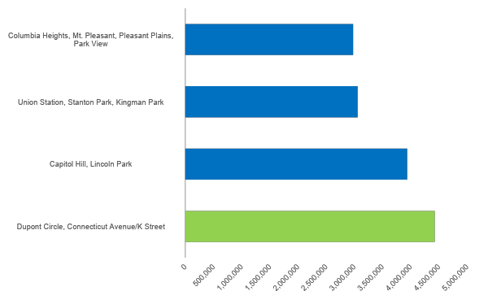
The Best 5 Neighborhoods Generating Revenue

Slide 5
Average Revenue of each Property Type in Washington D.C.

Slide 6
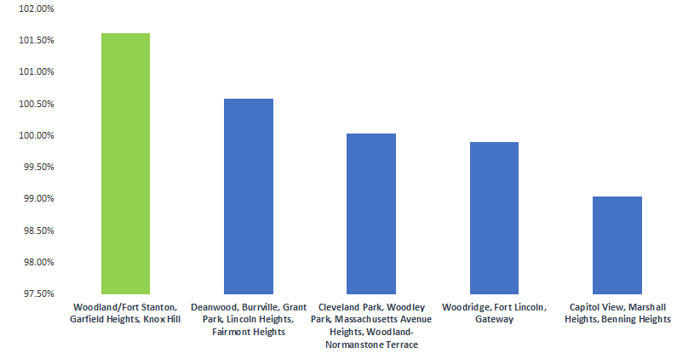
Neighborhoods With The Best Properties Reviews

Slide 7
Findings & Recommendations
Findings:
1. The best Neighbourhood Generating Revenue is "Dupont Circle, Connecticut Avenue/K Street"
2. The best performing host is Hermosa, and has 2 properties in "Edgewood, Bloomingdale, Truxton Circle, Eckington".
3. Houses, Apartments & Bed and breakfast are the best performing property types based on Average Revenue.
Recommendation for the Client:
Based on this analysis, your Requirements and Capabilities, we can suggest which property in Washington DC you can invest in.
Notes:
20 24 خجم الخط

Slide 8
Special Thanks for Misk Foundation
Mr. James & Mr. Naser for the Support & Guidance

Slide 9


